Slide 1


CSB4301 - WEB TECHNOLOGY
B.Tech – V Semester
Dr. Muthukumaran M
Associate Professor
School of Computing Sciences,
Department of Computer Science and Engineering

Slide 2
Unit 4- Flux Architecture?

Slide 3
What Is Flux?
Application architecture
• Can be treated more like a pattern
• Uses unidirectional data flow
• There are a lot of different implementations

Slide 4
Advantage of Flux
It is a unidirectional data flow model which is easy to understand.
It is open source and more of a design pattern than a formal framework like MVC architecture.
The flux application is easier to maintain.
The flux application parts are decoupled.

Slide 5
What Is Flux?
Flux is an architecture that Facebook uses internally when working with React.
It is not a framework or a library. It is simply a new kind of architecture that complements React and the concept of Unidirectional Data Flow.
A typical Flux architecture will leverage this Dispatcher library, along with NodeJS's EventEmitter module in order to set up an event system that helps manage an applications state.

Slide 6
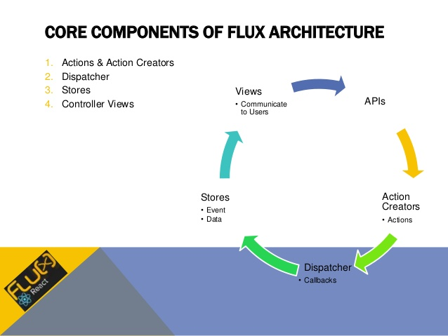

Slide 7
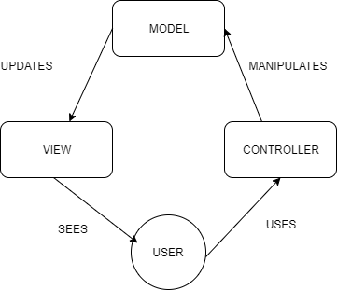
MVC model: An MVC model basically captures the entire state of the application and any changes you want to make to the model from the view will have to go through the controller to the model.

Slide 8
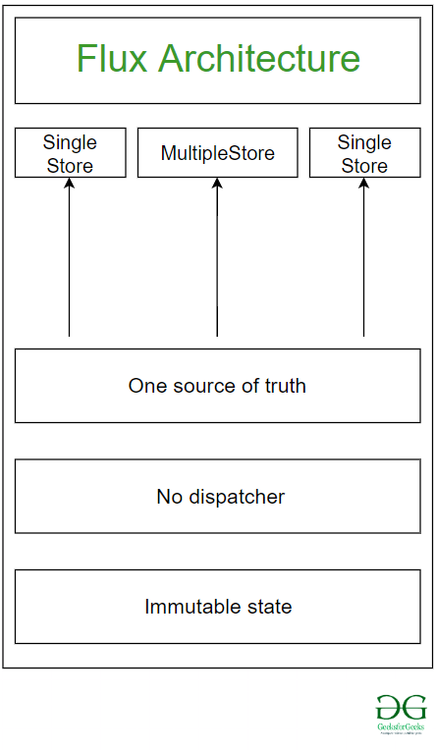

Slide 9
INDIVIDUAL COMPONENTS
Actions - Helper methods that facilitate passing data to the Dispatcher
Dispatcher - Receives actions and broadcasts payloads to registered callbacks
Stores - Containers for application state & logic that have callbacks registered to the dispatcher
Controller Views - React Components that grab the state from Stores and pass it down via props to child components.

Slide 10
ACTION
Typically triggered by the View
Contains information about change made to the application
{
actionType: "UPDATE_TITLE",
payload: "This is a new title."
}
Create an index.js file in the js/constants folder and use the following code to create your first action type:
export default {
ADD_NEW_ITEM: 'ADD_NEW_ITEM'
}

Slide 11
DISPATCHER ALL ABOUT?
The Dispatcher is basically the manager of this entire process.
It is the central hub for your application.
The dispatcher receives actions and dispatches the actions and data to registered callbacks.

Slide 12
The dispatcher’s API is simple, and it has only five methods available:
register(): Registers a store’s action handler callback.
unregister() : Unregisters a store’s callback.
waitFor(): Waits for the specified callback(s) to run first.
dispatch(): Dispatches an action.
isDispatching(): Checks if the dispatcher is currently dispatching an action.

Slide 13
var Dispatcher = require('flux').Dispatcher;
var AppDispatcher = new Dispatcher();
AppDispatcher.handleViewAction = function(action) {
this.dispatch({
source: 'VIEW_ACTION',
action: action
});
}
module.exports = AppDispatcher;

Slide 14
DEPENDENCIES
One of the coolest parts of the provided Dispatcher module is the ability to define dependencies and marshall the callbacks on our Stores.
So if one part of your application is dependent upon another part being updated first, in order to render properly, the Dispatcher's wait For method will be mighty useful.
ShoeStore.dispatcherIndex = AppDispatcher.register(function(payload) {});

Slide 15
case 'BUY_SHOES':
AppDispatcher.waitFor([
ShoeStore.dispatcherIndex
], function() {
CheckoutStore.purchaseShoes(ShoeStore.getSelectedShoes());
});
break;

Slide 16
Stores
In Flux, Stores manage application state for a particular domain within your application.
From a high level, this basically means that per app section, stores manage the data, data retrieval methods and dispatcher callbacks

Slide 17
var AppDispatcher = require('../dispatcher/AppDispatcher');
var ShoeConstants = require('../constants/ShoeConstants');
var EventEmitter = require('events').EventEmitter;
var merge = require('react/lib/merge');
// Internal object of shoes
var _shoes = {};
// Method to load shoes from action data
function loadShoes(data) {
_shoes = data.shoes;
}

Slide 18
// Merge our store with Node's Event Emitter
var ShoeStore = merge(EventEmitter.prototype, {
// Returns all shoes
getShoes: function() {
return _shoes;
},
emitChange: function() {
this.emit('change');
},
addChangeListener: function(callback) {
this.on('change', callback);
},
removeChangeListener: function(callback) {
this.removeListener('change', callback);
}
});
// Register dispatcher callback
AppDispatcher.register(function(payload) {
var action = payload.action;
var text;
// Define what to do for certain actions
switch(action.actionType) {
case ShoeConstants.LOAD_SHOES:
// Call internal method based upon dispatched action
loadShoes(action.data);
break;
default:
return true;
}
// If action was acted upon, emit change event
ShoeStore.emitChange();
return true;
});
module.exports = ShoeStore;

Slide 19
Action Creators & Actions
Action Creators are collections of methods that are called within views (or anywhere else for that matter) to send actions to the Dispatcher.
Actions are the actual payloads that are delivered via the dispatcher.

Slide 20
var keyMirror = require('react/lib/keyMirror');
module.exports = keyMirror({
LOAD_SHOES: null
});

Slide 21
var AppDispatcher = require('../dispatcher/AppDispatcher');
var ShoeStoreConstants = require('../constants/ShoeStoreConstants');
var ShoeStoreActions = {
loadShoes: function(data) {
AppDispatcher.handleAction({
actionType: ShoeStoreConstants.LOAD_SHOES,
data: data
})
}};
module.exports = ShoeStoreActions;

Slide 22
CONTROLLER VIEWS
Controller views are really just React components that listen to change events and retrieve Application state from Stores.
They then pass that data down to their child components via props.

Slide 23
var React = require('react');
var ShoesStore = require('../stores/ShoeStore');
// Method to retrieve application state from store
function getAppState() {
return {
shoes: ShoeStore.getShoes()
};
}
// Create our component class
var ShoeStoreApp = React.createClass({
// Use getAppState method to set initial state
getInitialState: function() {
return getAppState();
},
// Listen for changes
componentDidMount: function() {
ShoeStore.addChangeListener(this._onChange);
},// Unbind change listener
componentWillUnmount: function() {
ShoesStore.removeChangeListener(this._onChange);
},
render: function() {
return (
<ShoeStore shoes={this.state.shoes} />
);
},
// Update view state when change event is received
_onChange: function() {
this.setState(getAppState());
}
});
module.exports = ShoeStoreApp;

